Slide 1
Entity-Relationship(ER) Model
Entity-Relationship Model is a high level conceptual data model
Entity
“thing” in real world with independent existence (dependents don’t have independent existence)
Physical existence - employee, student, tree, laptop
Conceptual existence – department, courses
Has attributes – particular properties that describe an entity

Slide 2
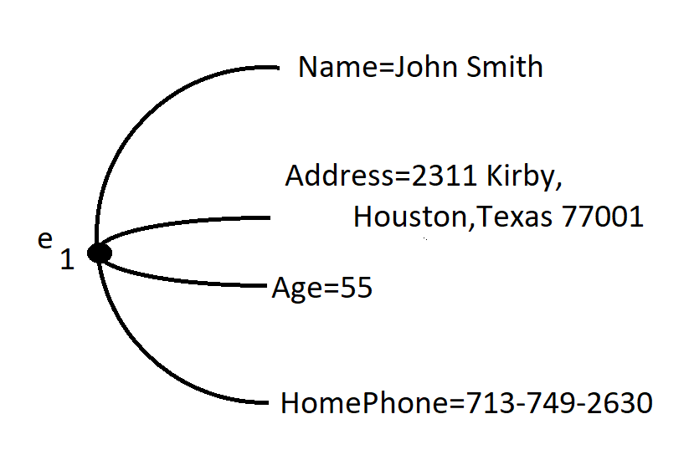
Employee Entity

Slide 3
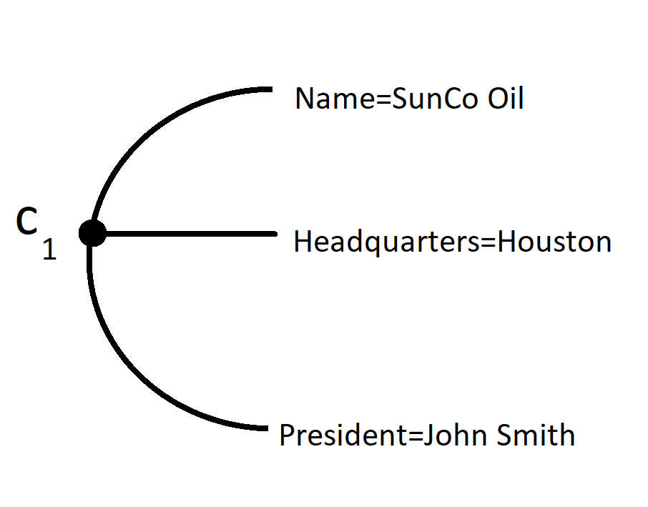
Company Entity

Slide 4
Entity-Relationship(ER) Model
Attributes
Simple(Atomic) and Composite attributes
Social Security Number (Aadhar Card Number)
Address made up of Door No., Street, Locality, District, State, Pincode
Composite attribute is a concatenation of constituent simple attributes
Composite attributes exist b’cos the components have to be individually addressed
Otherwise the entire attribute like the entire address can be treated as a simple attribute

Slide 5
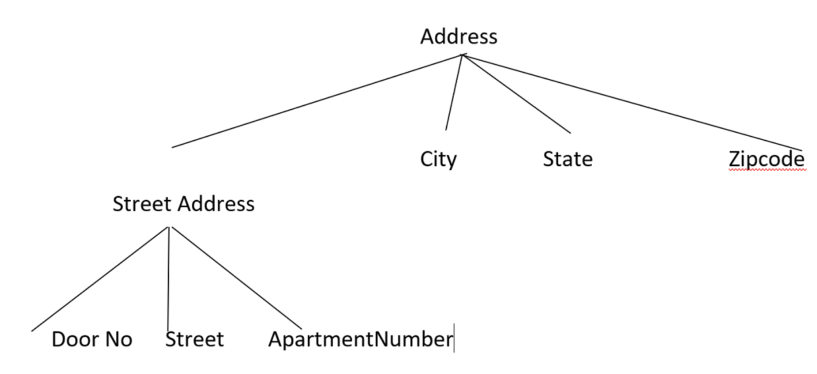
Composite Attribute

Slide 6
Entity-Relationship(ER) Model
Single valued and Multi-valued attributes
Age – single valued
No. of degrees – multi valued ; different values for different people, example, 0,1,3
Range of values for multi valued attributes eg., 0 to 3 in the above case

Slide 7
Entity-Relationship Model
Stored and Derived Attributes
Deriving age from date-of-birth and current date
Age is a derived attribute
Deriving from related attribute
Ex. Department using related entity employee to calculate staff strength

Slide 8
Entity-Relationship Model
Null values
Ex.
Apartment number for a single house
College Degrees for a person without degree
1st case-attribute exists, but value is not known Ex. Height of a person
2nd case-attribute does not exist, Ex HomePhone No. of JohnSmith does not exist

Slide 9
Entity-Relationship Model
Complex Attributes
Arbitrary nesting of composite and multivalued attributes
Composite attributes – components grouped within () and separated by comma
Multivalued attributes – grouped within {}
Ex:
{AddressPhone( {Phone(AreaCode, PhoneNumber)},
Address(StreetAddress(Number, Street, ApartmentNumber), City, State,Zip))}

Slide 10
Entity Relationship (ER) Model
{ ₁ AddressPhone( ₂ { ₃ Phone( ₄ AreaCode, PhoneNumber ) ₄ } ₃ ,
Address( ₅ StreetAddress(₆ Number, Street, ApartmentNumber ) ₆ , City, State,Zip)₅ ) ₂ } ₁
AddressPhone made up of Phone and Address
Phone is a composite attribute, also multi valued
Street Address is composite
Address is composite and multi valued by virtue of multi valued Phone attribute

Slide 11
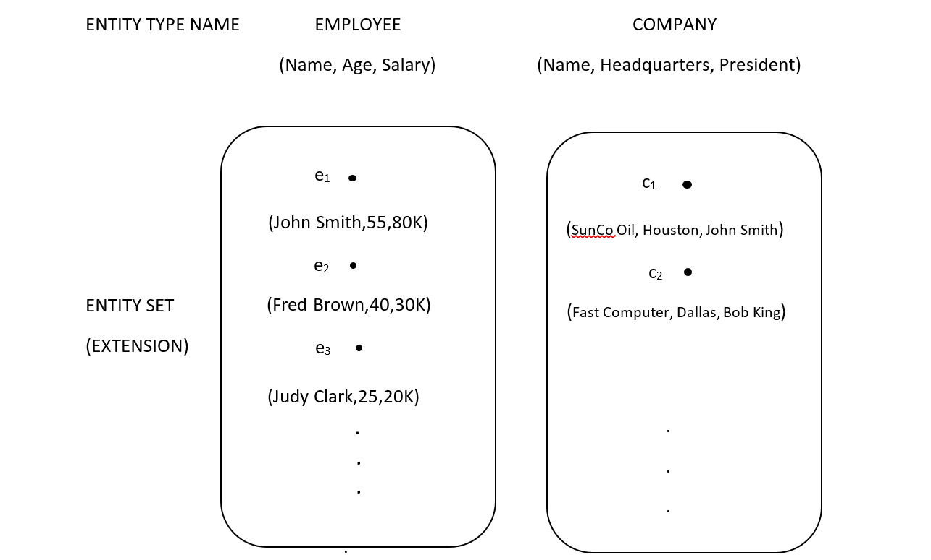
ENTITY TYPE AND ENTITY SET

Slide 12
ENTITY TYPE AND ENTITY SET
Entity Type
Defines collection(set) of entities that have the same attributes
Employee has attributes Name, Age and Salary
Company has attributes Name, Headquarters and President
Schema or Intension
Entity Set
Collection of all entities of a particular entity in the database at any point in time
Extension of the entity type

Slide 13
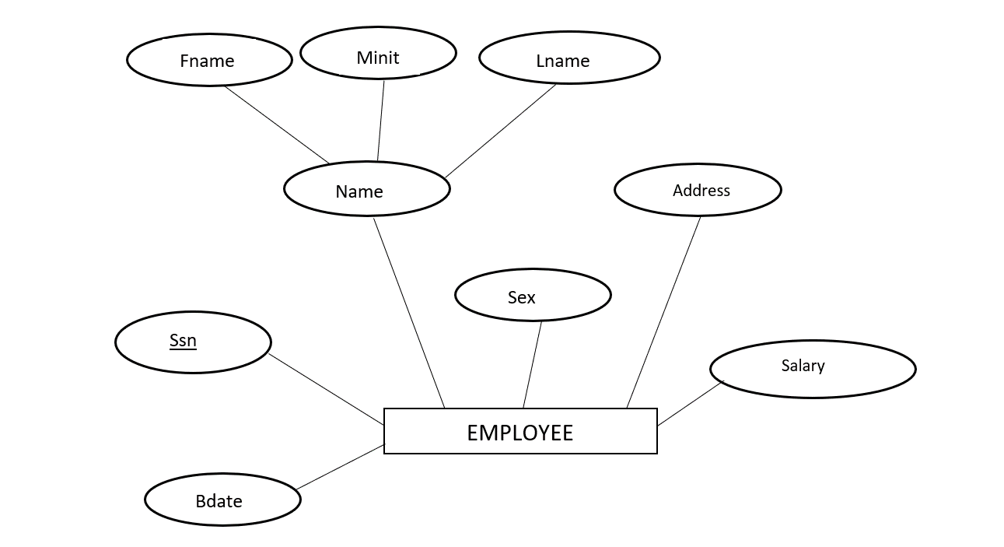
Employee entity in E-R diagram

Slide 14
Modifications to employee entity
Include composite attribute address
Include number of degrees – multivalued attribute
Representation of multivalued attribute

Slide 15
Multi-valued attributes
Name
No. of degrees
PERSON
Ssn

Slide 16
Entity-Relationship Model
Key or Uniqueness constraint on attributes
Key attribute – key with distinct values for each individual entity
COMPANY entity
name is attribute key
No two companies can have the same name
PERSON entity
Ssn-social security number (refer previous slide)

Slide 17
Entity Relationship Model
Combination of attribute values must be distinct
Such a composite attribute becomes a key attribute
Composite attribute should be minimal
Each component should make the key attribute unique
Key is underlined

Slide 18
Entity Relationship Model
Some entities have more than one key
Called candidate keys
Any one is chosen as the primary key
Ex. License Number and Vehicle Number(Registration Number)
Registration Number is a combination of State and Registration Number
Entity without key is a weak entity

Slide 19
Entity Relationship (ER) Model
Value Sets (Domains) of Attributes
Each attribute is associated with a value set or domain
The values in the value set can be assigned to the attributes
Ex. Age attribute of employee can range from 16 to 70
Age can take any value in this range
Ex. Name attribute can take combinations of alphabets optionally separated by blanks.

Slide 20
Entity Relationship (ER) Model
DEPARTMENT
Name, Number, {Locations}, Manager, ManagerStartDate
Name and Number are separate keys
PROJECT
Name, Number, Location, Controlling Department
Name and Number are separate key attributes

Slide 21
Entity Relationship (ER) Model
EMPLOYEE
Name(FName,Minit, Lname),SSN, Sex,
Address, Salary, BirthDate, Department,
Supervisor, (WorksOn{Project, Hours})

Slide 22
Entity Relationship (ER) Model
DEPENDENT
Employee, DependentName, Sex, BirthDate, Relationship

Slide 23
SmartDraw Tool for ER Diagrams

